Slide 1
Daylight System using optical fibers

Slide 2
CONTENTS
Overview of required components
Plastic Optic Fibers
Fresnel lens
Cooling System
Summary

Slide 3
Components Required
Optical Fibers (POF)
Fresnel Lens
Infrared filter
Light Collector and Mirrors
Sun-tracking System
Micro-Controller
Light-Dependent Resistors.
Servo Motor.
Cooling Fins
Cylindrical Aluminium fins with hollow center.
The fins will be the act as the main component to cool off the heat generated near the infrared lens.

Slide 4
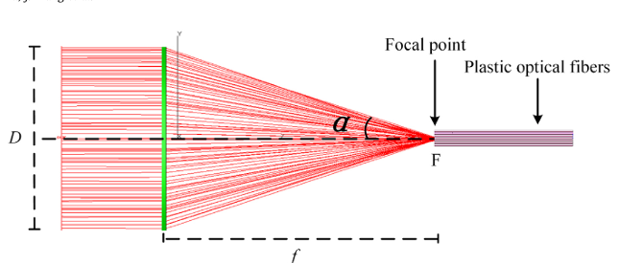
Plastic Optic Fibers

Slide 5
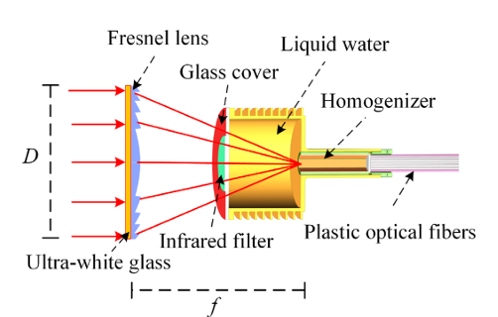
Fresnel Lens

Slide 6
Cooling approach for plastic fibers
PMMA plastic fibers have high tendency to absorb infrared light and poor heat resistance due to which they can be subject to melting/burning in working conditions. So, we need a cooling system to ensure this does not happen.
First we use infrared interference filters. These filters have high transmittance for visible light wavelength (400-800 nm) which reduces to nearly zero for 800 – 1100 nm range. This way, these filters transmit the visible light while efficiently reflecting the infrared part.
The next part using water and cooling fins is explained next.

Slide 7
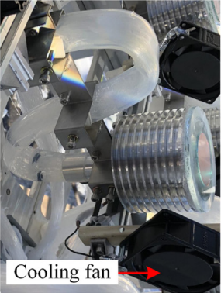
Cooling filter
In the integrated cooling system, the role of liquid water is to absorb near infrared light with wavelengths above 1080 nm, which is complementary to the infrared filter. At the same time, it plays a cooling role by cooling the fiber via convection, which is conducive to the safety of plastic optical fiber.
The fins around the water container lose the heat due to increased surface area which can also be aided by surrounding the fins with cooling fans.

Slide 8
THANK YOU

